Slide 1

TJS ENGINEERING COLLEGE (Approved by AICTE&Affiliated to Anna University Chennai & Accredited by NAAC) An ISO 9001 : 2015 Certified Institution
DEPARTMENT OF COMPUTER SCIENCE AND ENGINEERING
Project name : Smart Water Management
Phase-5
Team name : Proj_112821_team_3
Team members :
Sathish Kumar.S(112821104063)
Sai Kumar.S(112821104056)
Venkatesh.M(112821104072)
Yogesh.S(112821104076)
Srikanth.K(112821104068)

Slide 2
PROBLEM DEFINITION:
The project involves implementing IoT sensors to monitor water consumption
in public places such as parks and gardens. The objective is to promote water
conservation by making real-time water consumption data publicly available.
This project includes defining objectives,designing IoT sensor system
developing the data sharing platform and integrating them using IoT
technology and python.

Slide 3
OBJECTIVES:
The smart water system using IoT is an innovative solution that leverages the
IoT for management and conservation of water resources.
Water management problems such as water usage ,overflow in water tank. To
overcome this problem by implementing proper monitoring.
Through a network of sensors, the system collects real-time data on water
quality and consumption. This data is processed in cloud based platform.
It highlights potential of IoT in revolutionizing water management practices,
ensuring sustainable access to clean water for current and future generations.

Slide 4
Ultrasonic sensor:
It is used to indicate the level of water in real time. When the waterlevel falls below the threshold level the motor will automatically ON.
Ultrasonic sensors are electronic devices that calculate the target’s distance by emission of ultrasonic sound waves and convert those waves into electrical signals. The speed of emitted ultrasonic waves traveling speed is faster than the audible sound
Ultrasonic sensor working principle is either similar to sonar or radar which evaluates the target/object attributes by understanding the received echoes from sound/radio waves correspondingly. These sensors produce high-frequency sound waves and analyze the echo which is received from the sensor. The sensors measure the time interval between transmitted and received echoes so that the distance to the target is known.

Slide 5
Temperature sensor
It is used to sense the temperature of the water tank
Temperature sensors are devices that detect and measure coldness and heat and convert it into an electrical signal. Temperature sensors are utilized in our daily lives, be it in the form of domestic water heaters, thermometers, refrigerators, or microwaves.
A temperature sensor can also be defined as a simple instrument that measures the degree of coldness or hotness and then converts it into a readable unit. There are specialized temperature sensors used to measure the temperature of the boreholes, soil, huge concrete dams, or buildings.

Slide 6
Water flow sensor
Water flow sensors are installed at the water source or pipes to measure the rate of flow of water and calculate the amount of water flowed through the pipe.
The water flow sensor consists of a plastic valve body, a water rotor and a hall-effect sensor. When the water flows through the rotor, rotor rolls and the speed of it changes with a different rate of flow. The hall-effect sensor outputs the corresponding pulse signal.
A water flow sensor, on the other hand, measures the velocity of the fluid flow at a specific point in time. It is mainly used to monitor the flow rate in real-time, to detect any changes or irregularities in the flow, and to control or regulate the flow as needed.

Slide 7
Work flow of the system
This current proposed water management system focuses on the management of the water resources by monitoring the water level, temperature of the water and the flow of the water.
In this system, three sensors are used. Ultrasonic sensor is used to detect the level of the water, Temperature sensor is used to detect the temperature of the water and Water flow sensor is used to detect the flow of the water.
All these data which is derived from the sensors are stored and those data are used to analyse the condition of the water.
Hence the necessary action will be taken based on the condition of the water

Slide 8
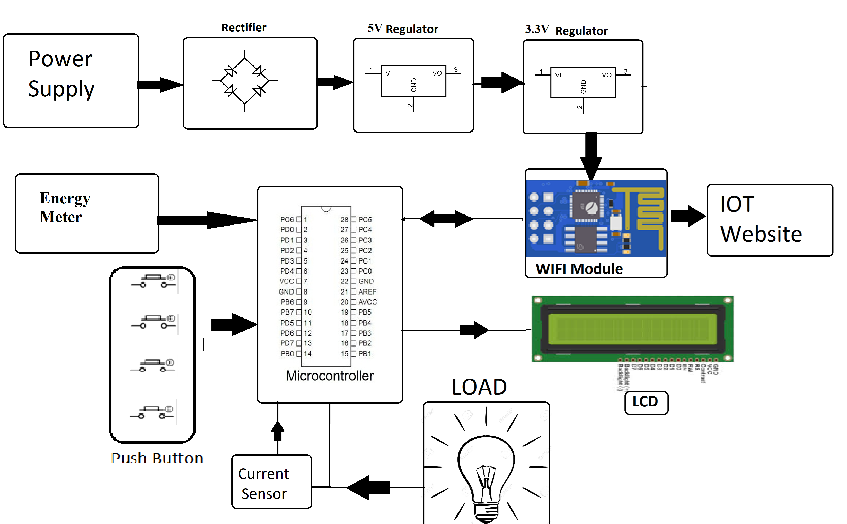

Slide 9
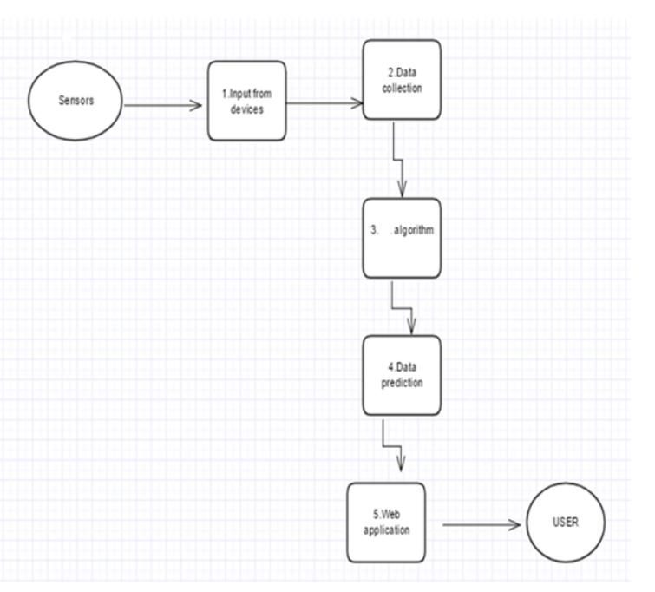
BLOCK DIAGRAM

Slide 10
Software required
Python
IOT Cloud Platform
IBM Cloud
Node-Red
IBM IOT Platform

Slide 11
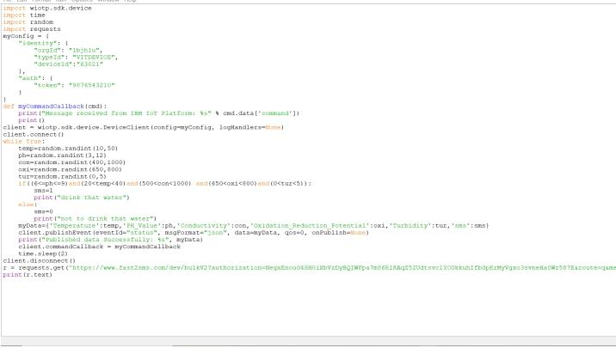
Code

Slide 12
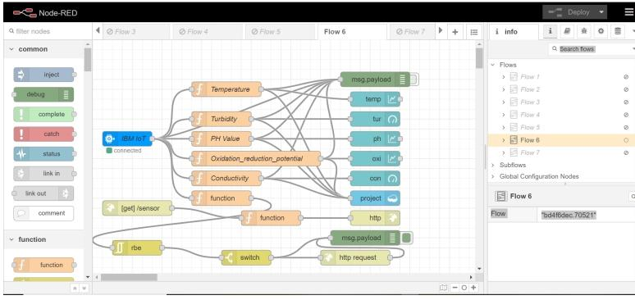
Node red-schematic view

Slide 13
Conclusion
The low cost, efficient, real-time water quality monitoring system using IBM Watson has been implemented and tested. Through this system, the officials can keep track of the levels of pollution occurring in the water bodies and send immediate warnings to the public. This can help in preventing diseases caused due to polluted water and presence of metals.The real time system which performs the monitoring of the water resources is established using the IOT sensors and the IBM cloud platform.

Slide 14
THANK YOU

